Slide 1
Mid-Year Presentation
for
Inviol Body-Camera Project
Presented By: Julia Borlase, Sai Gamana Putta , Lingze Meng ,Haoge Ming & Ray Crescent Garcia

Slide 2
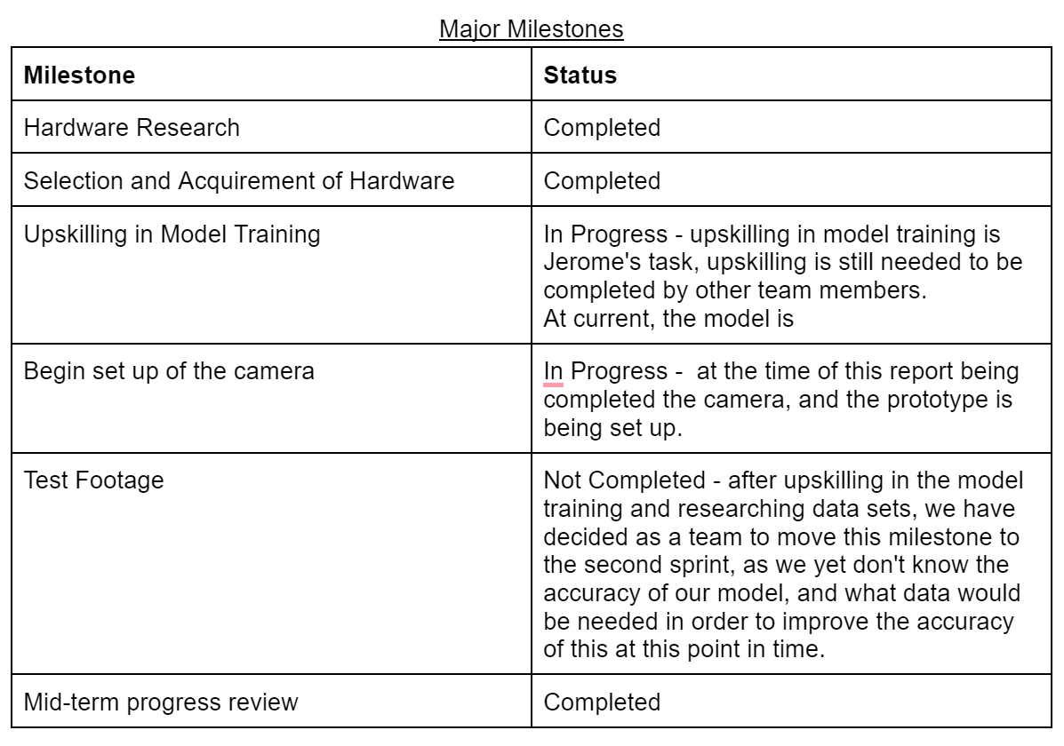
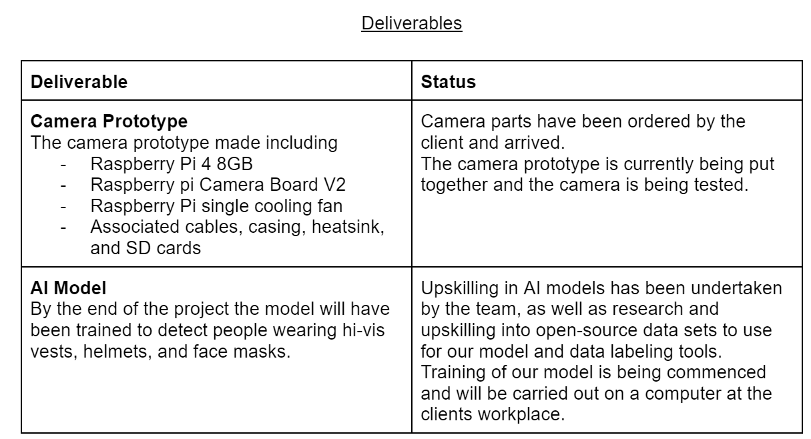
Description & Overview
Project Description
Project Objectives
Project Scope
Project Approach
Project Milestones
Project Deliverables
Notes:
Project Description
Inviol is a start-up company that aims to identify and remove complacency in the workplace by implementing cameras running AI vision. Inviol aims to reduce the number of workplace accidents by providing a way of removing complacency and stopping dangerous practices before they become fatal.
Our project is to create a prototype of a body-worn camera to assist inviol in detecting a lack of PPE (personal protective equipment) from a first-person perspective. We are also training a model in YOLOv4 to detect these breaches in policies.
Overview of Project
Objectives
Camera prototype with raspberry pi and pi camera module 2
Second objective is to train a YOLO v4 model to detect incorrect wearing of PPE (hivis, helmets and face masks)
To aid in these objectives, research into data collection and data sets is being carried out, aids in model training and allows us to include our own data to the model training to allow the model to be more accurate to our situations
Scope
Scope has been narrowed down to ensure completion of the project following feedback.
Scope include the camera prototype, the model being trained in YOLO v4, research and upskilling requirements, and collection of data sets (both open source and from the pi camera)
The narrowing of the scope allowed our team to focus on what was important to the project and allowed us to have a clear vision of what the end product would look like, and how we will achieve this.
Approach
Our approach includes creating a weekly schedule and report for the team and then individual schedules. Each week these are sent to the mentor on a tuesday.
Our approach for sprint one was focused on upskilling and research and acquiring the hardware.
Our teams adopted approach of divide and conquer for research and upskilling allowed individual members to become more knowledgeable in certain areas, and allows all of us to help each other out when it comes to applying this knowledge collectively to the project.

Slide 3
Response to Feedback
Project Proposal Formatting
Gantt Chart Adjustments
Weekly Reports and Schedules
Narrowing the Scope
Notes:
Project Proposal Formatting
After submitting our project proposal, roopak gave us ideas on how to better improve it. The main improvements included numbering our pages so that our table of contents was easier to use and using rough estimates and a range of values for our ‘Cost Estimate’ document as it didn’t give a very clear idea of how much budget was required for the project
Gantt Chart Adjustments
As for our Gantt chart, it originally only contained milestones relevant to part one, but after receiving mentor feedback, it is now extended all the way through to the end of part 2 in November.
Gary will go into specifics regarding the Gantt Chart later
Weekly Reports and Schedules
Our mentor was also concerned that some of our team members were not putting in the 12-15 hours of work required to work on the project every week. To remedy this, we began making weekly schedules that show what each individual in the group will work on throughout the week as well as fill out a weekly status report that we show to our mentor every week. The report goes over whether or not an individual’s tasks were complete, what went well, and if there had been any changes to tasks planned in the schedule. We repeat this process every week to ensure that all members are putting in the required effort and that our mentor stays in the loop.
Narrowing the Scope
For narrowing the scope, after our project proposal presentation earlier this semester you guys gave feedback regarding how the scope of the project was too ambitious, so we have since adjusted it as Julia mentioned before.

Slide 4
Variations and Summary
These points were provided to our team following the project proposal. The points detail how we have responded to this feedback.
Provide a clear list of deliverables identifying what you must deliver and what would be nice to deliver.
Include a clear plan with deadlines against deliverables
Go into more detail as to how the project methodology is iterative and point out where the iterations occur on WBS
Build a clear project-relevant risk register
We would be adjusting the upskilling plan by adding more time to upskilling.
Summary of Current Project Status
All required planning documents.
Received and in the completion process of all the hardware setup for the camera
Anything related to data collection.
Currently, we are supposed to finish setting up the Raspberry Pi camera module.
Considering some of the upskilling topics
The dataset for model training has been collected
Notes:
Provide a clear list of deliverables identifying what you must deliver and what would be nice to deliver.
The current scope was too ambitious (identifying and connecting camera, reading data, putting it through AI to identify behaviors, creating a mobile app, creating a website)
Based on feedback from the mentor, moderator, and client, our project deliverables narrowed down to the prototype of the camera - Raspberry Pi Camera Module 2 and having the YOLOv4 model trained to detect incorrect wearing of PPE- hi-vis, helmets and facemasks, body camera recording this data and making sure the body-worn camera prototype is now operational.
Include a clear plan with deadlines against deliverables
The current plan is very risky and also had no details that allow monitoring of progress.
Scope changed to just the research of the camera and the software to go on it. Mention the software that has already been made and just needs to be changed for our cameras
The plan was updated to two semesters' worth of work to reflect the plan of the project timeline.
Go into more detail as to how the project methodology is iterative and point out where the iterations occur on WBS
To reflect the iterative approach our methodology has and be very clear of how the objectives can be successful. .
Build a clear project-relevant risk register
Each milestone or deliverable has its own risks, the current risk register is very generic and some more details are required.
We would be adjusting the upskilling plan by adding more time to upskilling.
We found the time allocated to each skill is not enough due to the complexity of each task required and the need for upskilling on the go.
Summary of Current Project Status
The project is currently undergoing the hardware setup of the Raspberry Pi Camera Module 2 and having the YOLOv4 model trained and data understanding phase. A consultation with the client revealed that more time needed to be spent on adapting and clarifying the data set's purpose, as well as investigating YOLOv4 training and individual upskilling. This lead our team to focus on making the folders and some datasets for the data training (Photos for PPE have been collected, and videos collection for other scenarios is still progressing) then we connect it to the darknet on the google collab, and our custom detector training is done. We have decided as a team that we will use CVAT for data labeling due to its ease of use and ability to download and convert to YOLOv4 data.
So far, we have completed;
All required planning documents.
Received and in the completion process of all the hardware set up for the camera
Anything related to data collection.
In the project we are having issues with the following:
Currently, we are supposed to finish setting up the Raspberry Pi camera module. We are delayed due to not having a monitor setup. We had originally planned to enable camera settings on the laptop, however, this did not happen as planned.
Considering some of the upskilling topics are extensive and complex, as well as our other commitments affecting our ability to complete the upskilling within the time, we have re-evaluated this and updated it with new deadlines.
The dataset for model training has been collected whilst we are not sure of the exact amount of dataset that needs to be required to get an accurate result for our model training.
Initially, we had issues within the team with tracking the work progress which have been resolved when our team was given feedback by the mentor to create weekly schedules and weekly reports which had all the progress of the work and the goals being achieved by the individuals. Now, these issues do not exist due to some infrastructure of weekly schedules and weekly reports being set up and collaboration to improve these issues.

Slide 5
Recommendations
Have a complete plan for the project from start to end
- Expectations for projects are within our capabilities
- Assignment of individual work based on each individual's strengths as soon as possible
- Summarize the problems everyone have encountered then ask
Notes:
in the this semester, our team had a lot challenges and problems during the project. Based on those problems. we have made the following recommendations for team performance improvement
First. In our first few drafts of proposal, we only planned the part that we need to complete in front of us, which released our lack understanding of the project. According to the feedback from mentor, I have concluded that we need have a complete plan for the project from start to end. In this way, we can clarify what we actually goanna do in this project and also let readers to have a clear understanding of our project.
Secondly, we will reckon we can make our (target) of projects with in our capabilities, at our planning phase we had too many ideas in our mind want archive, and we put most of them in our project proposal, but in fact these ideas either beyond our capabilities or it is taken too long to implement.so we will recon next time be based on the client's suggestion and our own summarize, carefully pick one or two goals that we can actually do, and make it Perfect.
Thirdly Our previous working mode always like all of us focuses on one thing together, which reduces our work efficiency. Based on our mentor advice we want to Assign individual work to all the members based on each individual's strengths as soon as possible, by doing so we can combine everybody’s strengths together, increases the productivity of our group and ensures that everyone's has the same contribution to the team .and it is also fair to all the members
Finally, for our experience, we found that when we had some questions, if we can record it first then bring it to the team meeting. And after summarizing and discussion the problem, then ask mentor or client for advice. It is much better than asking the them directly. This can save everyone's time; speed up the progress of our project and also improve our problem-solving ability, because many problems have already been solved during our discussion.

Slide 6
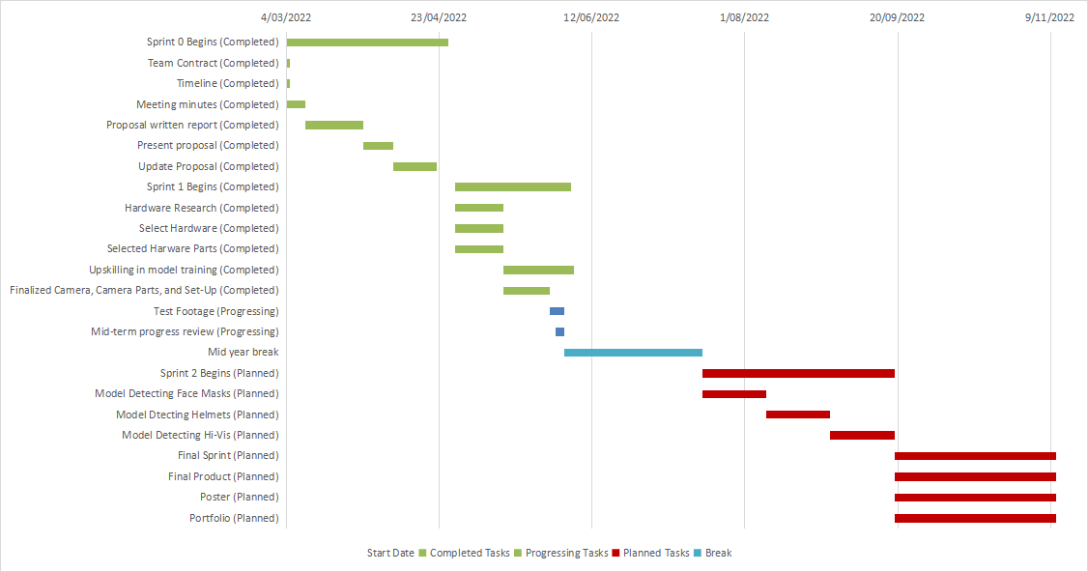
Updated project schedule (Gantt chart)
Note:
Completed tasks (Green colored bar)
Processing tasks (Blue colored bar)
Planned tasks in Part 2(Red colored bar)
Notes:
Schedule divided 3 parts as Completed tasks, Processing tasks and Planned tasks in Part 2.
Sprint 0 and 1 have already completed and the process is successfully follow the timeline strictly.
In part 2 works will be focused on model detecting and final product making.
From now on, we have already completed the tasks in Sprint 0 & 1, During the previous term, we completed tasks following the timeline strictly. This ensured that we completed the appropriate tasks at the midterm as planned. In this updated schedule, all the completed tasks were displayed as a Green coloured bar. And processing tasks were displayed as a Blue coloured bar. The planned tasks which will be completed in Part 2 are also listed in the schedule as a Red-coloured bar. In part 2, we will focus our works on model detecting for each scenario and make out the final product which already displayed in the Gantt chart. The whole project is expected to end on 9 November if the progress could be strictly followed to the timeline on the schedule.
Model training scenarios: Face masks, High-Vis, Helmet

Slide 7
References
Inviol - https://www.inviol.co.nz/

